Slide 1

Powered By
SciQuest

Slide 2
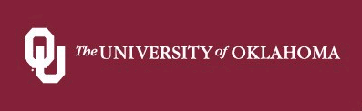


Welcome to CrimsonCorner
Town Hall
April 2012
along with
enables you to

Slide 3
The Focus Is On You
Norman Campus Community
Purchasing
Financial Services
IT
Huron (ePro SME) SkyBridge (PSFT SME)

Slide 4
The Flow of this Introduction
A Review of the Focus Groups Slide
  What is CrimsonCorner ? 6
  SciQuest 7
  OU’s Journey 8
  CrimsonCorner’s Benefits and Opportunities 9, 10
  CrimsonCorner’s Processes 11
  CrimsonCorner’s Environment Relative to PeopleSoft 12
  User Involvement In The Project 13
Shopping Carts 14
  What goes through CrimsonCorner 15
  Punch-out Catalogs 16
  Hosted Catalogs 17
  Forms 18
  What doesn’t go through CrimsonCorner 19

Slide 5
The Flow (continued)
The Important Message To The Campus Slide
  Helping Each Other Morph
    Business Process Transformation = CHANGE 21, 22
  CrimsonCorner Is What We Teach 23
    Supply Chain Management 24, 25
      The Internal Control Environment 26
        Hence: The Roles 27
  Change 28 - 38
  Quotes on Change 40
  Next Steps 41
Roles
Data-Driven
Receiving
Invoices
Imaging
Matching
Tolerances
Pcard
Pricing
Work Shifting
Control Over Invoices
Freedom

Slide 6
What is
?
Electronic Procure to Pay
Online shopping
“Best and Busiest” OU suppliers…
Robust online requisition routing
Electronic PO dispatching
Best suppliers submit invoices electronically
Best suppliers take payment via ePayables
Online invoice exception approval routing capability

Slide 7
SciQuest powers CrimsonCorner
Market leader in eProcurement software for higher education and research institutions
Over 100 higher education institutions, representing more than 194 campuses, are SciQuest customers
98% customer satisfaction rate
98% customer renewal rate
SciQuest customers include:
  Oklahoma Medical Research Foundation
  Oklahoma State University
  University of Missouri
  University of Kansas
  University of Texas
  Texas Tech
  Yale, Johns Hopkins, MIT, Harvard…

Slide 8
OU’s journey
Procurement studies from UNC, UC Berkeley and Cornell indicated decentralized purchasing resulted in disparate pricing, proliferation of suppliers, lost budget-stretching opportunity
OU’s peer institutions are utilizing best-in-class eProcurement with improved results
Opportunity to:
  Increase customer satisfaction through improved
  processes and pricing
  Better influence departmental spend for improved OU discipline
  Move market share to best and busiest vendors and leverage that spend to negotiate ever-better pricing and terms
Project is consistent with OU’s Operational Efficiency initiatives
Shop to Payment process in a single system
Today
Rollout
Future

Slide 9
Benefits
Ease of use
  Online shopping.
  OU specific catalogs.
  Single point of access to multiple OU custom vendor websites.
  Shortcuts and favorites.
Visibility
  Real time status.
  Visual workflow and payment status eliminating the ‘black hole’.
  Online history from Requisition to Payment.
Compliance and Exposure
  Shifting activity away from Pcard reduces inherent Pcard exposures.
Speed
  Automatic order transmission.
  Real time processes.
  Ability to copy previous orders, reducing data entry.
Efficiencies
  Electronic document handling and storage.
  Ability to place small and high dollar orders through one system.
  Electronic processing.
    More robust approval workflows.
    Electronic orders/invoices.
    Lean and Green.
Budget Stretching
  Production (more/better) per payroll $$.
  Improved contract pricing over time.

Slide 10
Opportunities
Current
Future
Various purchasing methods: PO, Pcard, Misc Invoices.
Low visibility into order/payment status.
Procurement effort spent on one-off, non-strategic contracts.
Settlement effort spent on processing miscellaneous invoices.
Audit trail varies by purchasing method; increasing risk.
Low and high dollar orders processed through a single system. Processing goal is to shift activity toward POs and away from Misc Invoices (primarily) and Pcard.
Full transparency for all users into order/payment status.
Procurement focus on campus-wide strategic contracts; users ordering off preferred contracts.
Improved settlement processes will enable better cash management and will strengthen compliance.
Consistent audit trail among majority of transactions. Req>PO>Invoice>Voucher>Payment

Slide 11
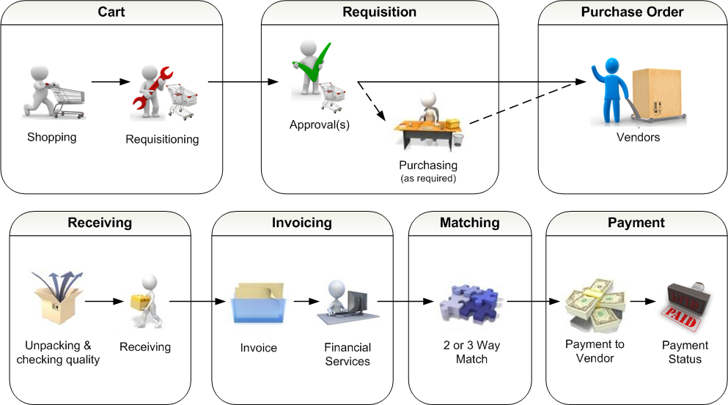
CrimsonCorner’s Processes

Slide 12
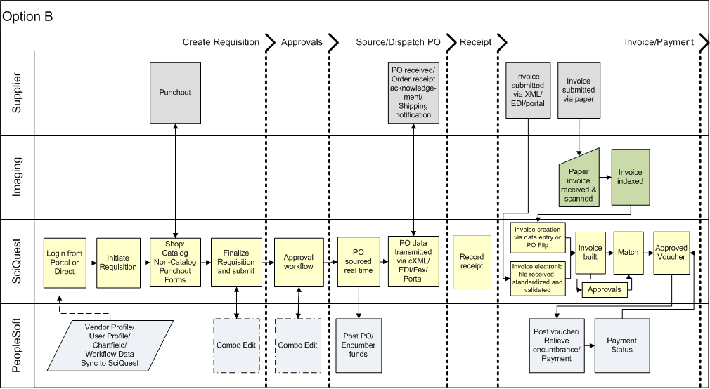
CrimsonCorner and PeopleSoft
CrimsonCorner will become the primary system for users
PeopleSoft remains OU’s System of Record
The integration makes it all work smoothly
Crimson Corner

Slide 13

User Involvement In The Project
Spring 2011 |  | Nov ‘11 | Dec ’11 | Jan ‘12 | Feb ‘12 | Mar ‘12 | Apr ‘12 | May ‘12 | Jun ’12 | Jul ‘12 | Aug ‘12 | Sep ‘12
Needs Analysis
Design and Build
Test
UAT
Live Order Test
Customer Service
Extensive outreach to gain understanding of current pain points and business needs
Focus Group 1
Town Halls
Focus Group 2
Town Halls
User Acceptance Testing
Set Up Webinars
Business Process Transformation
Communication, Town Hall, Ongoing Business Process & System Training
Go-live
Notes:
- Need exact dates for Prototyping and Focus groups

Slide 14
Shopping Carts
The first step in the purchasing process, the shopping cart represents the selected product list of a Shopper.
Shopping cart information can be populated from any source (punch-out catalog, hosted catalog, forms) and can contain requests from multiple vendors.
A Shopper may manage and maintain multiple carts at the same time.

Slide 15
So…What Really Goes Through CrimsonCorner ?
  All items available on (slides 16, 17)
  Any item that can be acquired using a Form (slide 18)
Just about everything unless otherwise directed (slide 19)
Independent service providers (FEIN)
Standing orders
Conference registrations
Reimbursements (employee and non-employee)
Independent contractors (SSN)
Subscriptions and Memberships $5,000 or less
Cell phone bills by direct pay or reimbursement (but let’s try to push to Pcard)
Food and beverage
Postage
Individual licenses – required by law / code (plumbers, electricians)
Lodging (if by direct payment)

Slide 16
Punch-out Catalogs
Shoppers access a supplier’s custom OU website from within CrimsonCorner with no additional logins. They search, select, and add items to temporary carts and then pull those items into their CrimsonCorner shopping carts.
Environments most of us are familiar with
Planned Punch-out Suppliers . . .
Fisher or. . .
VWR
Sigma-Aldrich
Life Technologies
Qiagen
Cardinal Health
BioRad
OfficeMax or. . .
Staples or. . .
OfficeDepot or. . .
Copelins
Complete Book
Grainger
Dell
HP
CDW-G
GovConnection

Slide 17
Hosted Catalogs
Suppliers provide contracted products and pricing via an electronic catalog hosted within CrimsonCorner . Shoppers can search and select across multiple catalogs and suppliers, and then add those items to their CrimsonCorner shopping carts.
While there are some advantages that hosted catalogs provide over
punch-outs, Shoppers will be more familiar with punch-out environments. OU will activate hosted environments only insofar as they represent best value, or if the supplier is not able to offer a punch-out environment.
Planned Hosted Suppliers. . .
SKC

Slide 18
Forms
Custom OU documents within CrimsonCorner. They support unique product or business process requirements. Forms are also used to electronically facilitate internal paper processes such as purchase order change requests, miscellaneous invoices, etc.
Planned Forms
Payment Request Form
Multi-Purpose Non-Catalog Item Form
Independent Contractor From
Phone / Data / Internet Payment Request
Food & Beverage Payment Request
Membership Payment Request
Subscription Payment Request
Standing Order
Change Order
Royalty Payment Request
Request to Lease a Multifunctional Copier or Printer
Request to Acquire a Printer not on University Contract
Subcontract

Slide 19
So…What Doesn’t Go Through CrimsonCorner ?
Submit to Financial Services
Scholarships
Participant payments
Refunds
Travel claims
Awards
Petty cash / change funds
Sales tax remittances
Use Pcard
Cell phone bills
FedEx / UPS
Conference registrations when in compliance with University policy
Whenever required at time of purchase and in compliance with Pcard guide

Slide 20
The Important Message. . .
to
The
Campus

Slide 21
Helping Each Other Morph
Spring 2011 |  | Nov ‘11 | Dec ’11 | Jan ‘12 | Feb ‘12 | Mar ‘12 | Apr ‘12 | May ‘12 | Jun ’12 | Jul ‘12 | Aug ‘12 | Sep ‘12
Needs Analysis
Design and Build
Test
UAT
Live Order Test
Customer Service
Extensive outreach to gain understanding of current pain points and business needs
Focus Group 1
Town Halls
Focus Group 2
Town Halls
User Acceptance Testing
Set Up Webinars
Business Process Transformation
Communication, Town Hall, Ongoing Business Process & System Training
Go-live
Notes:
- Need exact dates for Prototyping and Focus groups

Slide 22
Helping Each Other Morph
Business Process Transformation
Communication, Focus Groups, Town Halls, Business Process Scrutiny, Training, Usage, LEAN, Continuous Improvement
A K A
C H A N G E
Notes:
- Need exact dates for Prototyping and Focus groups

Slide 23

CrimsonCorner Is What We Teach

Slide 24
Supply Chain Management
(to paraphrase the previous slide. . . )
Supply Chain Management is the integrated management of the flow of materials and products, services, and information…to the final customer and back again. Through the use of Supply Chain Management, organizations are able to stretch their dollars further. This is a result of improvements in the areas of procurement, distribution, operations management, communication, and the capture and use of information.
Increasingly, technology is used to create these improvements.
Electronic commerce is one example of the use of technology in the supply chain management process.

Slide 25
Supply Chain Management
Integrated > Complete transaction history in a single place
Stretching dollars further > Disciplined approach over time. Use information to work with “best and busiest” suppliers to get best in class pricing by being a best in class customer.
Improvements in procurement > Use technology to process orders. Remold Procurement as a strategic sourcing service.
Improvements in operations management > Use technology to strengthen our internal control environment.
Improvements in communication > Use technology to pass information back and forth.
Capture and use of information > Use technology to expand the “data-driven university” out to the Procurement and Payment functions.
Electronic commerce > Exactly what CrimsonCorner is.

Slide 26
The Internal Control Environment
(do we really practice what we teach?)
From the March 2012 issue of Journal of Accountancy (page 28)
Five principles relating to the control environment:
Commitment to integrity and ethics.
Oversight for internal control by the board (of regents), independent of management.
Structures, reporting lines and appropriate responsibilities in the pursuit of objectives established by management and overseen by the board.
A commitment to attract, develop and retain competent individuals in alignment with objectives.
Holding individuals accountable for their internal control responsibilities in pursuit of objectives.

Slide 27




Hence: The Roles
Requisition
Requisition
Invoice
Shopper
Finds items and creates shopping cart(s)
Assigns cart(s) to Requester
Receiving
Requester
Can also shop
Enters accounting
Submits requisition for approval
Receiving
Department / Specialty Approvers
Reviews requisition for appropriateness
Department and specialty approvals
Purchasing
Reviews requisition for compliance before PO is dispatched to supplier
Financial Services
Manages the settlement process

Slide 28
Change
Roles
  Fundamental and Vital to internal control
  As much as possible
    Establish a good separation of functions
    Workflow in a single direction
      Try to avoid doubling back
Notes:
- Need exact dates for Prototyping and Focus groups

Slide 29

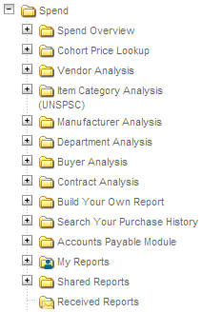
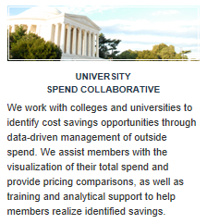
Change
Data-Driven
  CrimsonCorner captures the detail we will upload to the EAB (we are members) Spend Compass reporting tool
Notes:
- Need exact dates for Prototyping and Focus groups

Slide 30
Change
Receiving
  Electronic within CrimsonCorner
  IS the authority to pay
  Replaces signatures (on paper invoices)
  Requires training
  Requires great care
  Requires intelligence
Notes:
- Need exact dates for Prototyping and Focus groups

Slide 31
Change
Invoices
  To Financial Services If Procured through CrimsonCorner
    Not to Departments
  Imaging replaces hard copy
  eTransmission replaces snail mail
Notes:
- Need exact dates for Prototyping and Focus groups

Slide 32
Change
Imaging
  Purchases from > working on two options
    Scan at back-end
    Scan and attach to CrimsonCorner invoice
  CrimsonCorner purchases using Forms
    Images stay in CrimsonCorner pending permanent solution
  Transactions submitted to Financial Services
    Scan at back-end
  Pcard purchases
    Department remains responsible
Notes:
- Need exact dates for Prototyping and Focus groups

Slide 33
Change
Matching
  3-Way
  (1)PO to (2)Receiving to (3)Invoice
  Invoked when invoice is received
  There will be an exception process
  Clearing will take more time at start
Notes:
- Need exact dates for Prototyping and Focus groups

Slide 34
Change
Tolerances
  Accepted best practice
  At document header level
    Lesser of 5% or $100
  There will be an exception process
  Learning curve inevitable
  Requires patience in the beginning
  We’ll go after sloppy suppliers
Notes:
- Need exact dates for Prototyping and Focus groups

Slide 35
Change
Pcard
  CrimsonCorner approvals will compare unfavorably on front end (take longer)
  BUT (!!!)
    Transaction history will be unified in CrimsonCorner
    Line item detail available for analysis / benchmarking
    Pcard reconciliation won’t apply to CrimsonCorner transactions
    Pcard reviews could cover fewer transactions
Notes:
- Need exact dates for Prototyping and Focus groups

Slide 36
Change
Pricing
  Some catalog prices may not be lowest
  There will ALWAYS be instances of this
  BUT (!!!)
    Terms and conditions ARE extremely important
    Suppliers can’t reward fidelity if we’re not. . .
    Data gathering is assured within CrimsonCorner
    A process will be available for exceptions
Notes:
- Need exact dates for Prototyping and Focus groups

Slide 37
Change
Work Shifting
  It may appear that Administration is shifting work to Departments
  In fact. . .
    Approvals within Departments have always been necessary; they’ll just be moving from the back end to the front end of the transaction
    Key payoff is complete visibility of transaction progress and history within CrimsonCorner
Notes:
- Need exact dates for Prototyping and Focus groups

Slide 38
Change
Control Over Invoices
  It may appear that Departments will lose this
  In fact. . .
    Control will be different but stronger
    Departments will see the image of the invoice and where it is in the payment process
Notes:
- Need exact dates for Prototyping and Focus groups

Slide 39
Change
Freedom
  This may be viewed as a limitation of freedom
  In fact. . .
    It is widely accepted as best practice
    A strong internal control environment is vital to the University’s health
      Granting agencies require it
      Accrediting agencies require it
      The Board of Regents require it
    Trimming the supplier base will produce efficiencies
Notes:
- Need exact dates for Prototyping and Focus groups

Slide 40
Change
“If you wait to do everything until you’re sure it’s right, you’ll probably never do much of anything.” – Win Borden
“It’s kind of fun to do the impossible.” – Walt Disney
“Action will remove the doubt that theory cannot solve.” – Petryl Hsieh
“That some achieve great success is proof to all that others can achieve it as well.” – Abraham Lincoln
“If you do not change direction, you may end up where you are heading.” – Lao Tzu
“Fall seven times, Stand up eight.” – Japanese Proverb
Notes:
- Need exact dates for Prototyping and Focus groups

Slide 41
Next Steps
Communication, Communication, Communication
Testing, Testing, Testing
Training, Training, Training
Pilot
Go live
Feedback, Feedback, Feedback
Improve, Improve, Improve

